Slide 1

Smart Campus: Revolutionizing University Management
Transforming educational administration through cutting-edge digital solutions for a unified, efficient, and intelligent campus ecosystem.

Slide 2
01
02
03
Project Vision
Problems We Solve
Critical Features
Introducing Smart Campus, an enterprise-grade University Management System designed for digital transformation.
Addressing key challenges in administrative chaos, communication, and data management.
Highlighting advanced authentication, admin control, instructor tools, and student experience.
04
05
06
Technology & Architecture
System Capabilities
Business Impact & Advantages
Exploring the robust backend and innovative frontend powering Smart Campus.
Scalability, reliability, security, and performance at the core.
Operational efficiency, cost savings, enhanced experience, and competitive edge.
07
Future Roadmap & Key Takeaways
Looking ahead with AI, mobile apps, and strategic integrations.

Slide 3

The Smart Campus Vision
Smart Campus aims to revolutionize educational administration by creating a comprehensive, enterprise-grade University Management System. This platform fosters a unified ecosystem, enabling seamless interaction between administrators, instructors, and students, ultimately eliminating paperwork and streamlining all academic operations.

Slide 4
Solving University Administration's Core Problems
Administrative Chaos
Communication Barriers
Manual enrollment processes lead to delays and errors. Our solution automates workflows, reducing processing time by 80%.
Disconnected communication causes friction. We provide a centralized platform with real-time notifications for instant information flow.
Data Fragmentation
Inefficient Attendance Tracking
Scattered records across multiple systems create inconsistencies. Our unified database ensures a single, reliable source of truth.
Paper-based attendance is prone to inaccuracies. Digital marking with analytics ensures 100% accurate records and audit trails.
Exam Management Complexity
Resource Allocation Issues
Manual exam processes are time-consuming. Our integrated online system with automatic grading saves 70% in administration time.
Difficulty in managing instructor assignments. We offer intelligent assignment with conflict detection for optimized workload balance.

Slide 5

Critical Features for a Smarter Campus
Advanced Authentication & Security
Admin Control Center
JWT Token-Based Authentication with Role-Based Access Control (RBAC) ensures tailored permissions for Admin, Instructor, and Student roles. Secure password management and session control are built-in.
Comprehensive user and department management, course assignment, enrollment oversight, and a soft-delete system. Advanced search and an analytics dashboard provide powerful insights and control.
Instructor Empowerment Suite
Student Experience Platform
Tools for course management, exam creation with automated grading, attendance tracking, and student performance monitoring. Instructors can efficiently manage their academic responsibilities.
A personalized dashboard for course enrollment, online exams, progress tracking, and real-time notifications. Seamless assignment submission and instant feedback enhance the learning journey.

Slide 6

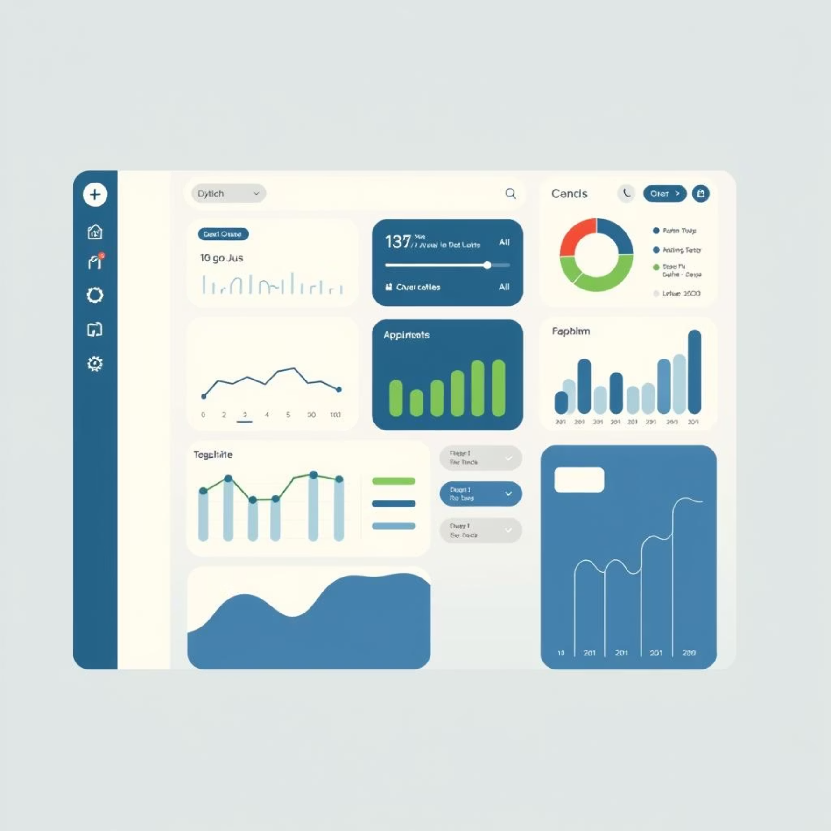
Comprehensive Data Management & Modern UI
Data Management Excellence
Modern User Interface
Our system boasts a robust data architecture:
Designed for optimal user experience:
Soft Delete Architecture: Archive and restore functionality means no data is ever truly lost.
Responsive Design: Seamlessly adapt across desktops, tablets, and mobile devices.
Audit Trails: Every change is tracked with timestamps and user attribution for full accountability.
Intuitive Navigation: Role-specific menus ensure ease of use for all stakeholders.
Data Validation: Multi-layer validation (Client, DTO, FluentValidation) ensures data integrity.
Real-Time Feedback: Toast notifications provide instant confirmation for all actions.
Pagination & Filtering: Efficiently handle large datasets with server-side pagination and advanced filtering options.
Accessibility: WCAG-compliant with full keyboard navigation support.
Modern Aesthetics: A professional sage-green theme with smooth animations for a polished look.

Slide 7
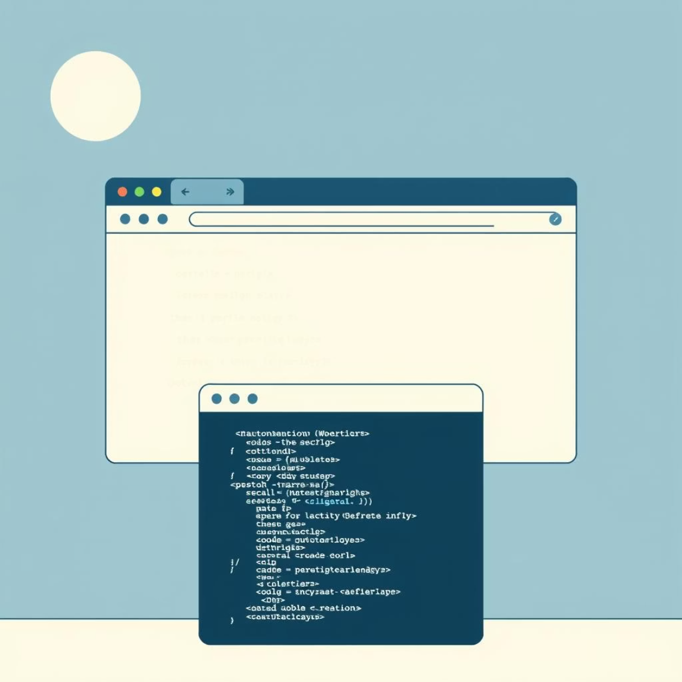


Technology & Architecture: The Foundation of Smart Campus
Backend Excellence
Frontend Innovation
Architecture Highlights
ASP.NET Core 8.0: Modern, high-performance web framework.
Vanilla JavaScript: Modern ES6+ with async/await.
N-Tier Architecture: Separation of Presentation, Business, Data layers.
Entity Framework Core: Advanced ORM with LINQ support.
Bootstrap 5.3: Responsive UI framework.
SQL Server: Enterprise-grade relational database.
Custom CSS: Modular, maintainable stylesheets.
RESTful API Design: Standard HTTP methods and status codes.
ASP.NET Identity: Robust authentication and authorization.
API Service Layer: Centralized API communication.
SOLID Principles: Maintainable, scalable code structure.
JWT: Stateless, secure authentication.
Token-Based State Management: Secure session handling.
Global Query Filters: Automatic soft-delete filtering.
FluentValidation: Sophisticated validation framework.
Notification System: Real-time user feedback.
CORS Configuration: Secure cross-origin communication.
Repository Pattern: Clean separation of concerns.
Swagger Documentation: Interactive API documentation.
Dependency Injection: Loose coupling and testability.

Slide 8

System Capabilities: Engineered for Excellence
Scalability
Designed to handle thousands of concurrent users with optimized database queries, efficient caching, and background job processing capabilities.
Reliability
Comprehensive error handling, robust transaction management with automatic rollback, and detailed logging ensure system stability and data integrity.
Security
Enterprise-grade protection with password hashing, SQL injection prevention, XSS protection, CSRF token validation, and API-level role-based authorization.
Performance
Optimized for speed with lazy loading, server-side pagination, efficient database indexes, and minimal API response times.

Slide 9


Business Impact & Competitive Advantage
Transformative Business Impact
Unmatched Competitive Advantages
Operational Efficiency: 90% reduction in manual tasks, real-time processing, and automated workflows.
Unified Platform: All academic operations in one seamless system.
Cost Savings: Paperless operations, reduced administrative overhead, and optimized resource allocation.
Modern Tech Stack: Built with the latest industry standards.
Enhanced Experience: Self-service for students, simplified tools for instructors, and comprehensive oversight for admins.
Scalable Architecture: Grows dynamically with institutional needs.
Data Intelligence: Real-time dashboards, historical trend analysis, and audit trails for informed decision-making and compliance.
User-Centric Design: Intuitive and accessible for all users.
Security-First Approach: Enterprise-grade protection.
Flexible Deployment: Cloud-ready and adaptable.
Comprehensive Features: An all-in-one solution.
Active Development: Continuous improvements and updates.

Slide 10

Future Roadmap & Key Takeaways
Future Roadmap: Innovating Ahead
Key Takeaways: Why Smart Campus?
AI-Powered Analytics: Predictive insights for student success.
Efficiency
Mobile Applications: Native iOS and Android apps for on-the-go access.
Automates repetitive tasks, reducing manual effort significantly.
LMS Integration: Seamless integration with Learning Management Systems.
Payment Gateway: Streamlined online fee payment system.
Accuracy
Messaging System: Internal communication platform.
Calendar Integration: Synchronized academic calendar.
Eliminates human errors for reliable data and processes.
Parent Portal: Dedicated access for families to track student progress.
Transparency
Provides real-time visibility for all stakeholders.
Scalability
Designed to grow seamlessly with your institution's needs.
Security
Offers enterprise-grade data protection and robust safeguards.
Experience
Delivers intuitive interfaces for an enhanced user journey.

